Slide 1
UNIT 4: STORY AND GAME CREATION

Slide 2
UNIT DESCRIPTION
This unit of study introduces the learners to the major elements of narrative for interactive environments. The focus is on the concepts of storytelling in relationship to game design. Learners will explore the fundamentals of narrative creation and the crucial importance of interactive storytelling. Learners will also use storyboards to create a visual sequence of story development and game play.

Slide 3


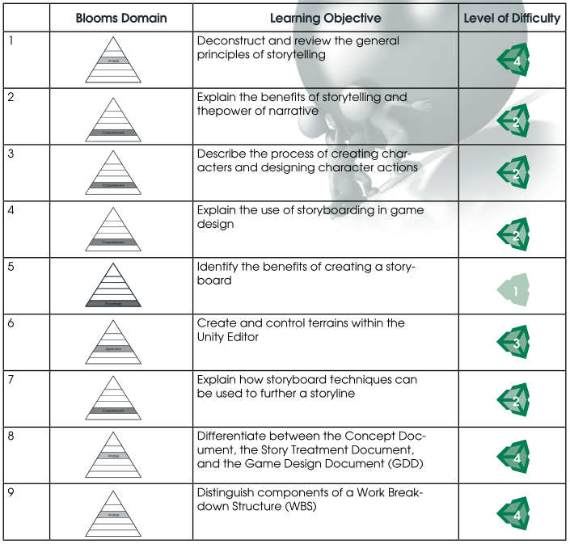
LEARNING OBJECTIVES
By the end of this unit, learners should be able to perform the following tasks:

Slide 4
COURSE OUTLINE

Slide 5




1. What is a story? Introduction to storytelling principles
a. Story structure
b. Storyline
c. Conflict and drama
d. Types of narrative

Slide 6
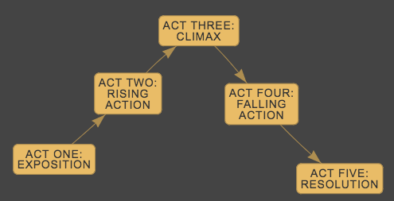
5 act structure

Slide 7
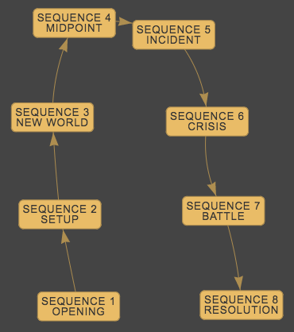
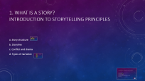

8 Sequence structure

Slide 8
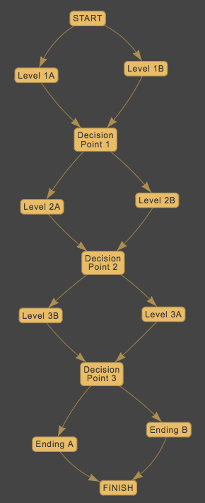
Parallel narrative

Slide 9
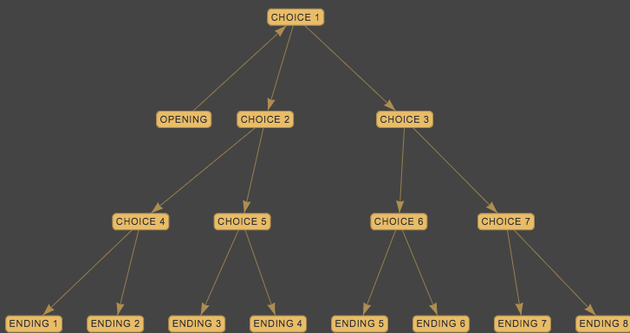
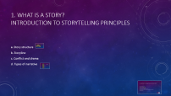

Branching narrative

Slide 10




2. Creating the characters for your story
a. Types of characters
b. Character archetypes
c. Character development elements
d. Visual development: appearance in the game
e. Verbal development: abilities, weakness and vulnerabilities, role in the game
f. Character backstory

Slide 11

Types of characters
Confidante- someone in whom the central character confides, thus revealing the main character’s personality, thoughts, and intentions. The confidante does not need to be a person.
Dynamic Character - a character which changes during the course of a story or novel. The change in outlook or character is permanent. Sometimes a dynamic character is called a developing character.
Flat Character - a character who reveals only one, maybe two, personality traits in a story or novel, and the trait(s) do not change.
Foil - a character that is used to enhance another character through contrast. Cinderella’s grace and beauty as opposed to her nasty, self-centered stepsisters is one clear illustration of a foil many may recall from childhood.
Round Character - a well developed character who demonstrates varied and sometimes contradictory traits. Round characters are usually dynamic (change in some way over the course of a story).
Static Character – a character that remains primarily the same throughout a story or novel. Events in the story do not alter a static character’s outlook, personality, motivation, perception, habits, etc.
Stock Character - a special kind of flat character who is instantly recognizable to most readers. Possible examples include the “ruthless businessman”, “shushing old librarian” or “dumb jock.” They are not the focus nor developed in the story.

Slide 12

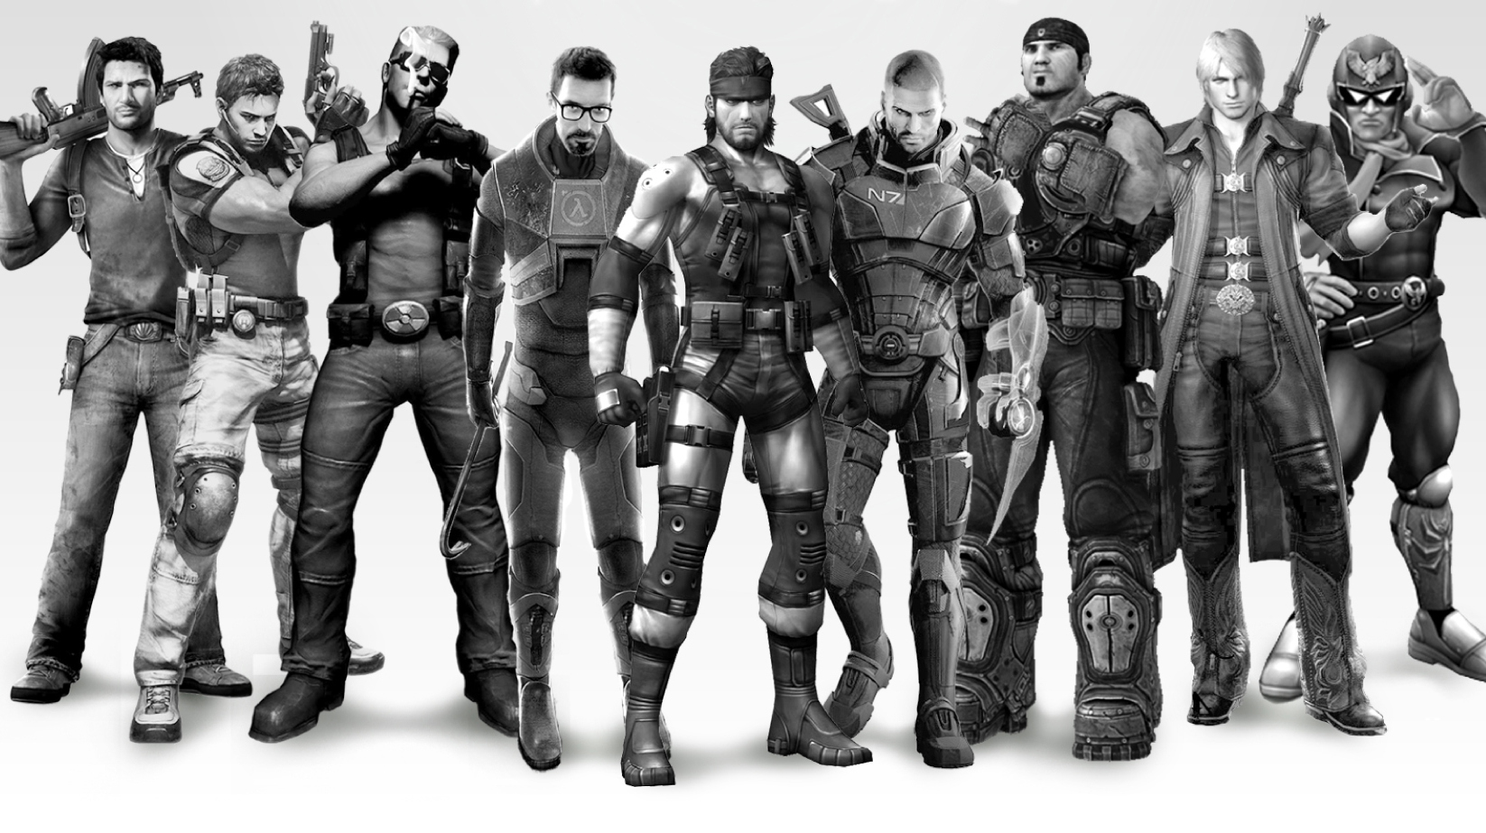
The Hero
Summary: The hero is always the protagonist (though the protagonist is not always a hero). Traditionally speaking, the hero has been male, though fortunately there are more female heroes appearing in contemporary literature (think Katniss Everdeen and Lisbeth Salander). The hero is after some ultimate objective and must encounter and overcome obstacles along the way to achieving this goal. He or she is usually morally good, though that goodness will likely be challenged throughout the story. Heroes’ ability to stay true to themselves despite the trials they must face is what makes them heroic. That and the fact that they are often responsible for saving a bunch of people (or hobbits, or wizards, or what have you).

Slide 13
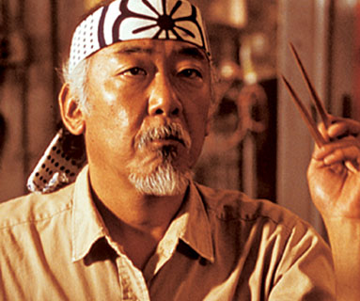
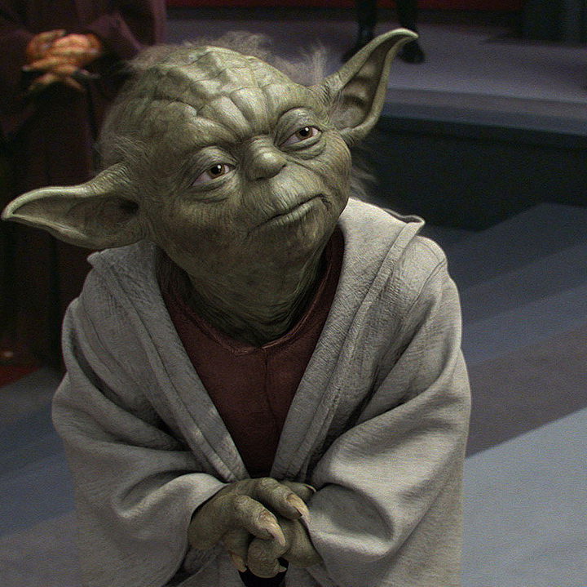
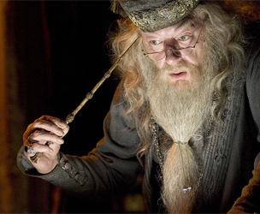
The Mentor
Summary: The mentor is a common archetype in literature. The mentor is usually old, and this person often has some kind of magical abilities or a much greater breadth of knowledge than others possess. Mentors help heroes along their journeys, usually by teaching them how to help themselves (though mentors sometimes directly intervene in extreme situations). The mentor often ends up dying but is sometimes resurrected or revisited even after death.

Slide 14
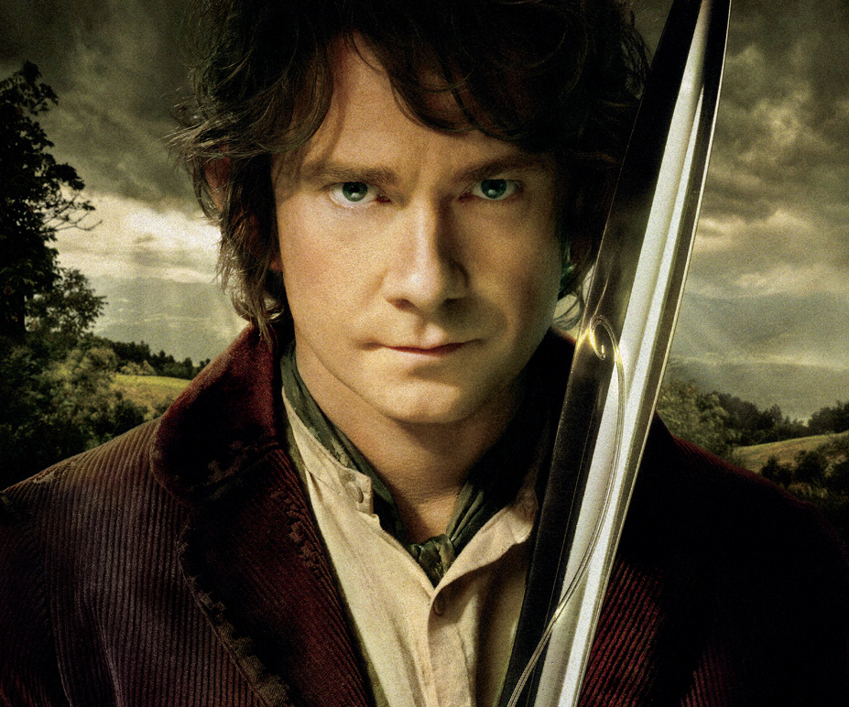
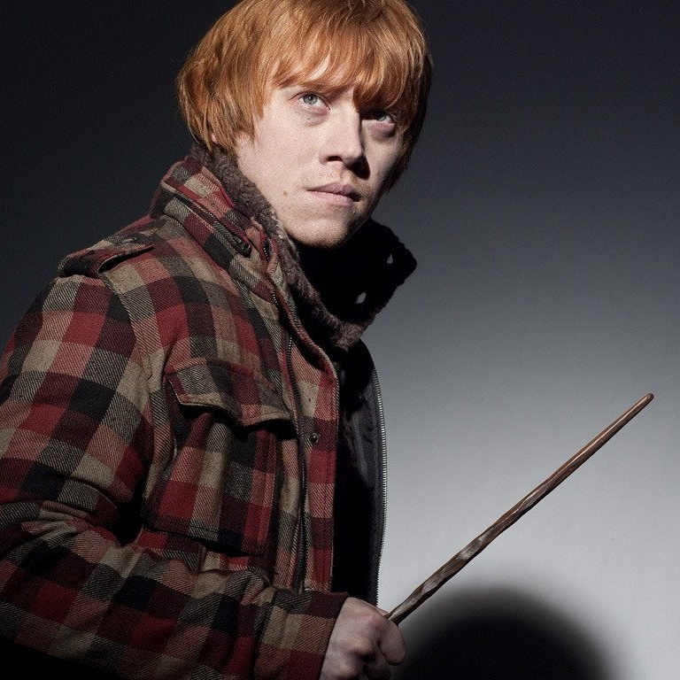
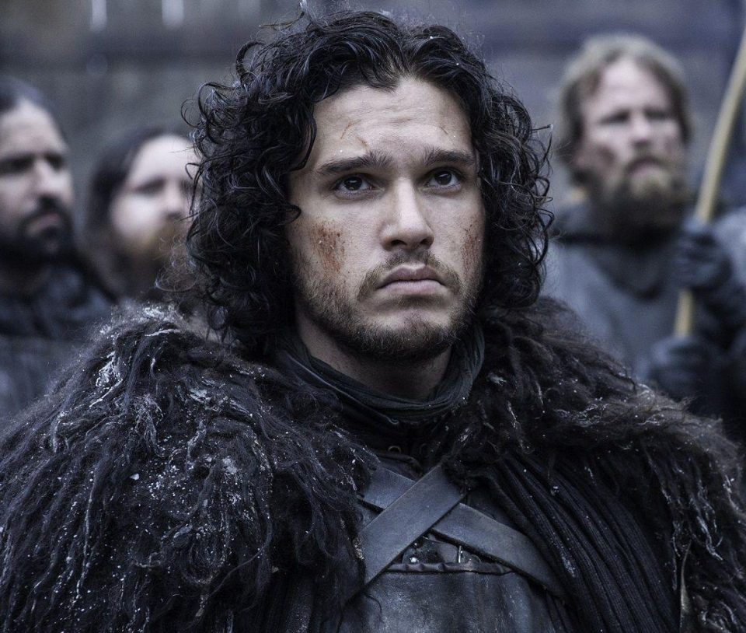
The Everyman
Summary: The everyman character archetype often acts as the stand-in for the audience. This character archetype is just a normal person, but for some reason, he or she must face extraordinary circumstances. The everyman can be the protagonist or a supporting figure. Unlike the hero, the everyman does not feel a moral obligation to his or her task; instead, these characters often find themselves in the middle of something they have barely any control over. Unlike the hero, the everyman archetype isn't trying to make a great change or work for the common good: these characters are just trying to get through a difficult situation.

Slide 15


The Innocent
Summary: Characters representing the innocent archetype are often women or children. These character archetypes are pure in every way. Though often surrounded by dark circumstances, the innocent archetype somehow has not become jaded by the corruption and evil of others. These character archetypes aren't stupid: they're just so morally good that the badness of others cannot seem to mar them.

Slide 16
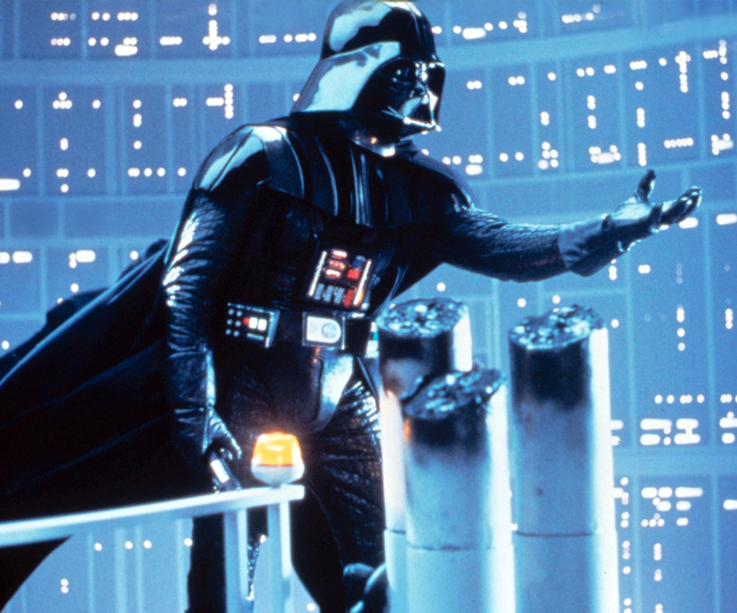
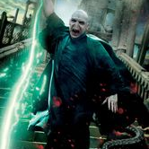


The Villain
Summary: The villain wants to stop the hero archetype from achieving his or her goal. The villain is often evil, though there is often a reason—however warped that reason may be—why villains are so bad. Villains often want nothing more than to control and have power over everyone and everything around them, probably because most of them are secretly strongly motivated by fear. Villains are often the moral foil of the hero: that is, their main vice will parallel the hero's main virtue.

Slide 17
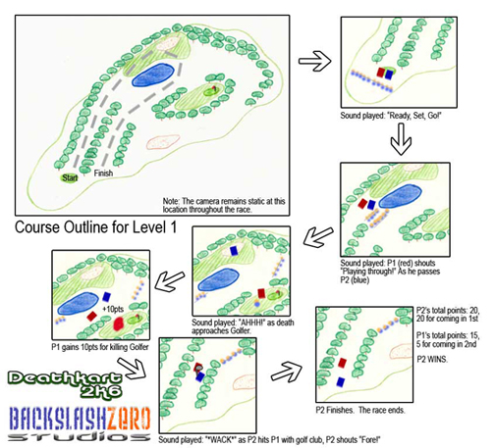
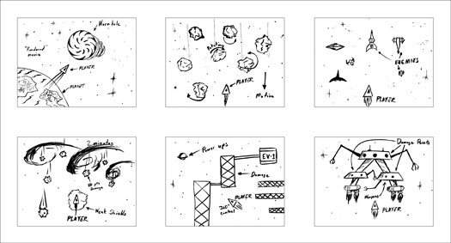
3. The importance of images in telling a story: storyboarding fundamentals
a. Why use a storyboard?
b. Use of sketches, text and technical instructions to provide thorough descriptions of video game levels, scenes, goals, etc.
c. Impact of sequence of frames in a storyboard and how this affects the story
d. Cues that help a visual storyteller to communicate ideas

Slide 18
Self pace learning

Slide 19
Exploring the Unity Editor
This tutorial below introduces the concepts of terrain and is a continuation of the development process for setting up a game build in the Unity Editor. This tutorial introduces the basic skills the learner will need to start any project in Unity. As learners finalize their game genre, story, and begin character development, the next tutorials will prepare them for bringing their storyboard to life within the Unity Editor. Provide time and opportunity for learners to complete the Terrain Sculpting Tutorial and previous tutorials as necessary to develop ability to begin the actual creation of their game for the Capstone Project.
Terrain Sculpting: https://unity3d.com/learn/tutorials/topics/graphics/terrain-introduction-heightmaps

Slide 20
Work Breakdown Structure (WBS) Exercise
In the last unit, learners were introduced to a basic project charter. In this unit, they will learn how to manage resources (i.e. time and talent) to accurate predict how long a project will take. They will also create a roadmap, which details the steps they need to take in order to meet the milestones to keep the project on track. The Work Breakdown Structure (WBS) document will be used to itemize specific tasks to be completed in order to finish a project. This can include very high level tasks as well as very detailed and highly specific tasks. For this part of the project, just enough project management is recommended and learners will only create a WBS for the higher level tasks. They will complete the WBS by listing the higher level tasks to be completed on the Capstone Project. This can be changed and edited as new knowledge and understanding of the process occurs.

Slide 21
Game Design Document (GDD) Entry
In your Game Design Document (GDD), create a storyboard for your game idea. This is still a pretty high level storyboard, so you do not need all the nitty-gritty details but at least a storyboard of the major story components. Jot down a few paragraphs of narrative that introduce your storyline. Introduce the back-story. What happened just before the action in the game – how did the main character end up in the situation they are placed at the beginning of the game? If your game does not have an actual storyline, jot down the background for how you developed the idea for your game. What was in your mind? Why do you think your idea is a good one? What was your inspiration? Remember your game will have a storyboard even if you are not developing a narrative type game.

Slide 22
Game Design Document (GDD) Entry
In your Game Design Document (GDD), provide details on the main characters and any supporting characters for your Capstone Project.
Write out the physical features of the character, using five bullet points.
Using the provided Character traits list, identify two dominant traits for your main character. Include an explanation of the character’s development of those traits.
In paragraph form, create a back story for the character. The back story must lead the character up to a point of current conflict, but does not need to include their current conflict. In paragraph form, write out emotional/personality of the character.
Create a draft for sections 1.5-Game Atmosphere, 1.6-Game Play, and 2.6-The Story in your Game Design Document (GDD). You will revisit and revise these sections as you learn more throughout the course.

Slide 23
Contemporary Game Assignment -1
Play Megaman X6 using psx emulator which already been uploaded on the google drive, watch the intro in the game.
Discuss how the intro sets the stage for gameplay. What kind of mood does the story create? Based on the story, what do you expect from gameplay? What type of environment do you anticipate? What kind of challenges.
Now play the game: Megaman X6. Explain how the game fits in with your expectations based on the initial backstory created via the intro. How would you have done the intro scene differently?

Slide 24
SUGGESTED RESOURCES
Which books, digital resources, & other materials will be used in this lesson? Listed below is a
recommendation of resources to consider for this unit:
1. The 7 keys of storytelling https://www.youtube.com/watch?v=hVcg9L6FLPA
2. Just Enough Project Management Text: http://www.amazon.com/Just-Enough-Project-Management-Indispensable/dp/0071445404 and for download: http://ebookee.org/Just-Enough-Project-Management_3617.html
3. Guide for Creating a Work Breakdown Structure: https://www.workbreakdownstructure.com/
4. Templates for WBS Creation: https://www.workbreakdownstructure.com/

